Slide 1
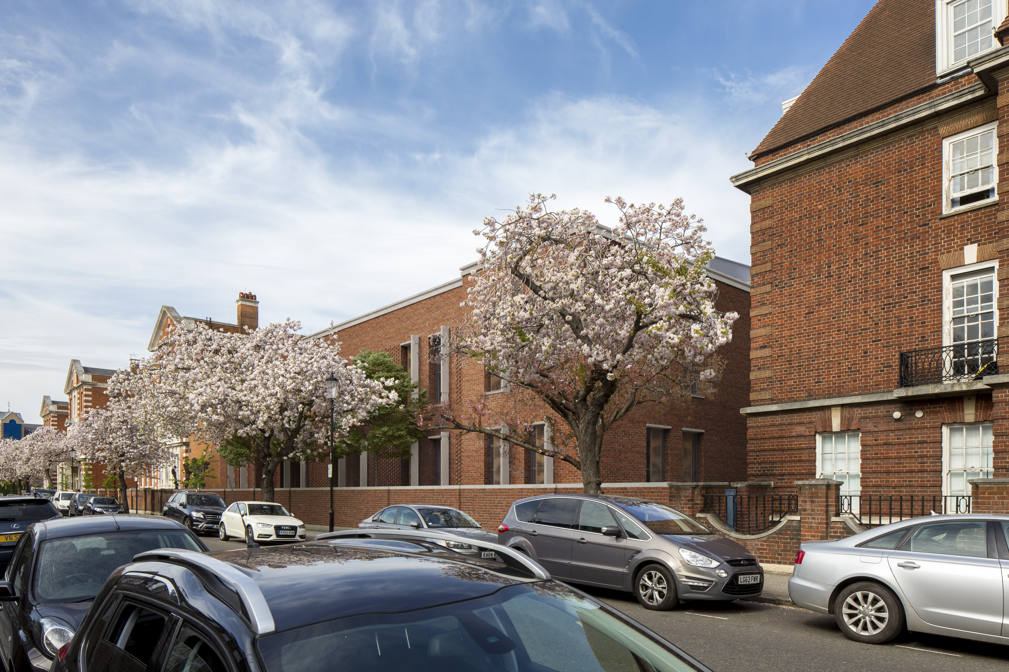


Royal Brompton Hospital
New Imaging Centre
Community Group Liaison
Meeting
27th March 2019

Slide 2
Agenda
Welcome
Project Introduction
Kier Introduction
Project Management Proposals
Construction Working Group & Next Steps
Q&A

Slide 3
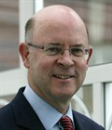
Project Introduction
Richard Paterson
Associate Chief Executive
Royal Brompton & Harefield NHS Foundation Trust
Notes:
Graham

Slide 4
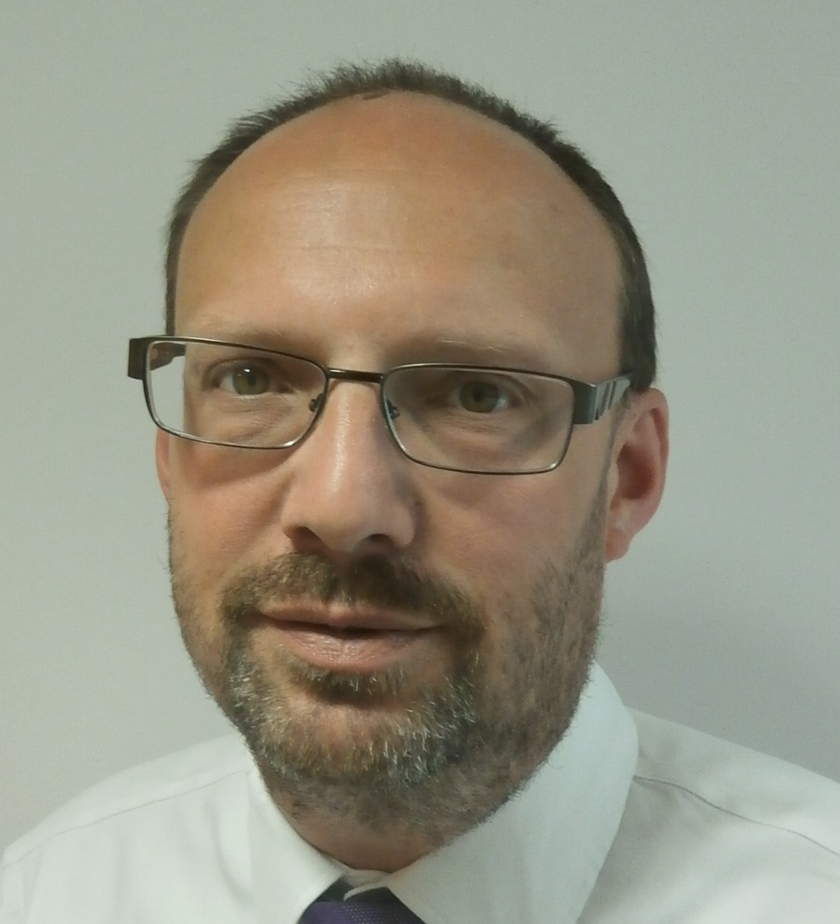
Kier Introduction
Alistair St. Clair-Smith
Contracts Manager
Kier Construction Ltd.
Notes:
Graham

Slide 5
Kier Introduction
Kier is a leading property, residential, construction and services group.
We operate across a broad range of sectors including defence, education, health, highways, housing, industrials, power, property, transport and utilities.
We offer a breadth of capabilities enabling us to bring together the right skills from across the business to provide an integrated offer to our clients.
£182m
£1,688m
2017 Revenue
£4,265m
£2,019m
£376m

Slide 6
Kier Construction London
Kier Construction delivers new buildings that enhance the built environment for communities and improve our quality of life.
As a provider of a comprehensive building and civil engineering service, we work with private and public sector clients across the UK and internationally.
We have the flexibility and expertise to build anything, anywhere – from £250k extension to a strategic asset costing hundreds of millions of pounds – making full use of our capabilities to benefit as many people and organisations as possible, and maximise the return for our clients and partners.
2017 Turnover
£187m

Slide 7
North Middlesex University Hospital, London
North Middlesex University Hospital NHS Trust
Commercial
Education
Health and
Science
Residential
General
Works
Heritage
Value: £55m
We successfully delivered five P21+ contracts on time and to budget. Works included extensive refurbishment and remodelling to stroke and HIV units, infrastructure and external works, a new women’s and children’s unit and complex refurbishment to six floors of the cardiology unit while two floors remained in use.
Demolition and Surveys – £1m
This section of works involved the demolition of six blocks and the commissioning of site waste surveys for preparation for the following stages of the re-development. Kier also constructed a temporary footpath and access ramp along with constructing the foundations for the child protection unit which is located next to the Women’s and Children’s Block.
Stroke and HIV Units – £5m
This section of works involved the remodelling/refurbishment of the existing buildings to provide new stroke and HIV
facilities. The HIV unit, formerly known as ‘TI Coleridge Unit’ moved into the Trust Headquarters in February 2013 and
was renamed the ‘Alexander Pringle Centre’. The facility provides diagnosis, treatment and support for patients
with HIV.
Infrastructure and External Works – £7m
This section of works involved the construction of infrastructure and external works in connection with the Women’s
and Children’s Unit. The services included the main generators which supply power to the new unit and are fed
underground via the existing maternity ward which remained in use throughout the construction process.
“The project was delivered on time and the partnership between the users, Kier and Yorkon, worked well . . . On the women’s and children’s building babies were being born within 4 hours of building completion . . . Kier was programme driven and communicated extremely well with all our stakeholders. Our staff and patients are delighted with the new facilities and I have absolute confidence in recommending them.”
Kevin Howell, Former Director of Environment –
North Middlesex University Hospital NHS Trust

Slide 8
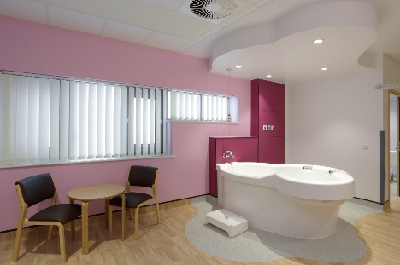
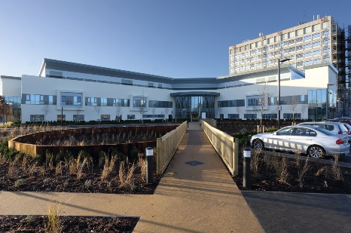
North Middlesex University Hospital, London
North Middlesex University Hospital NHS Trust
Commercial
Education
Health and
Science
Residential
General
Works
Heritage
Value: £55m
Woman’s and Children’s Unit – £21m
This building formed the Woman’s and Children’s Unit and contains additional high-dependency beds, two new obstetrics theatres, a neonatal unit, triage centre, woman’s outpatient department, a midwife-led birthing unit with four birthing pool rooms, a postnatal ward with discharge lounge and a transitional care unit to support neonatal care. The centre was constructed using pre-fabricated modules, which were constructed off-site by Yorkon and craned into position. In total there were 152 steel-framed modules up to 18m long and in many different sizes and configurations to suit the building’s design and site. At the time, this was the biggest and most complex modular healthcare scheme ever built in the UK. Due to the location of the site, next to the A406, there were a number of logistical challenges when taking delivery of the modules. Local authorities had to be informed of the potential disruption and traffic calming methods had to be put in place.
Retained Estates – £21m
This involved the design and construction of ‘Retained Estates’ including the
cardiology unit, podium and tower buildings. The work on the tower building
involved refurbishment of floors 1, 4, 5, 6, 7 and 8 whilst the second and
third floors remained in use throughout the works. It was important that the
construction work did not disrupt or interfere with the patients who were
being treated on the two operational floors. Sound proof screens were put
up around the hoist lift which was used to give access to the upper floors.
The works also included asbestos removal and strip back to the existing
structure. M&E services were installed on all the refurbished floors.

Slide 9
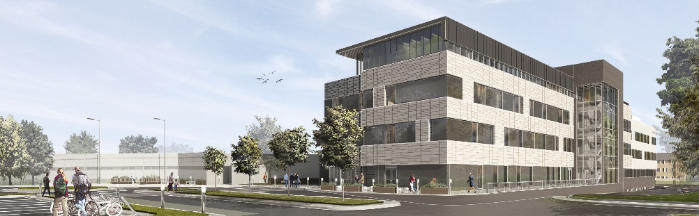
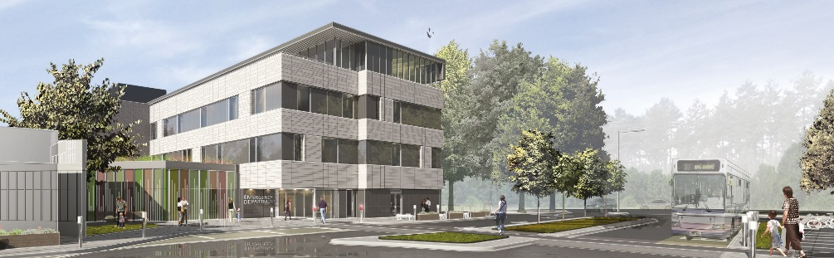

Wexham Park Hospital Emergency Department, Slough
Frimley Health NHS Foundation Trust
Commercial
Education
Health and
Science
Residential
General
Works
Heritage
Value: £35m
The works comprise of the construction of a new, four storey, emergency department at Wexham Park Hospital. The emergency department, located on the ground floor, comprises four separate departments; resuscitation, majors, minors and paediatrics. The new emergency department is supported by a Medical and Surgical Assessment Unit on first and second floor with staff accommodation provided on the third floor. The layout provides comprehensive patient care within one building, to avoid moving patient’s long distances across the hospital site. The floor plan has been designed to work efficiently during an emergency. An example of this is the ambulance parking is directly connected to resuscitation and very close to the majors department. The paediatric and minors department is located within close proximity to the main entrance of the emergency department so that patients can be efficiently processed and treated. The central spaces within the emergency department consist of assessment and imaging facilities with a link street to the existing hospital. The first and second floors consist of a mixture of four bed and single bedrooms for patients. These are provided with as much daylight as possible for the recovering patients. On these floors there is a central waiting area and staff work bases that can monitor all bays.
Awards
Bio Diversity Challenge 2018 – Community Engagement Finalist

Slide 10
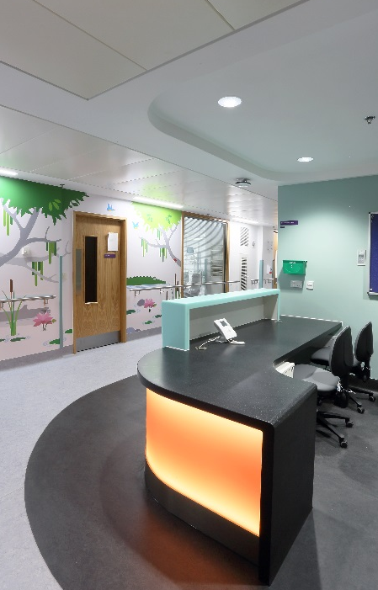
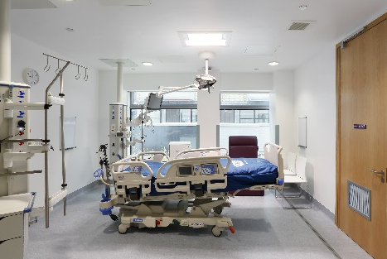
GOSH Major and Minor Works, London
Great Ormond Street Hospital NHS Trust
Commercial
Education
Health and
Science
Residential
General
Works
Heritage
Value: £45m
Kier are carrying out a scheme of multiple major and minor capital projects supporting the decant and enabling works required for Phase 4 of the GOSH master plan. Works included CBL Lifts - £400k and Chiller replacement - £1.2m.
Italian Hospital and Nursery - £TBCm: The works consist of converting the building to create a dedicated, self-contained sight and sound out-patients’ facility.
iMRI - £8m: Construction of a new iMRI unit within the courtyard area of Great Ormond Street Hospital. The unit will be constructed from a steelwork frame with insulated render cladding as the main external envelope. The building will comprise of two floors and a roof plant area with the theatre and iMRI unit on the first floor along with supporting rooms on the ground floor.
CT Scan and Spec CT - £3.3m: Refurbishment of the existing accommodation
to create a new Spec CT Scanner at Level 1 of the Variety Club Building. This
includes refurbishment to the existing Cath Lab rooms.
Squirrel Ward - £500k: The light refurbishment of the Squirrel Ward. These
works include replacement of flooring and ceiling tiles, reconfiguration of four
rooms, redecoration and repairs, alterations to the existing AHU system and
existing power and data within the wards.

Slide 11
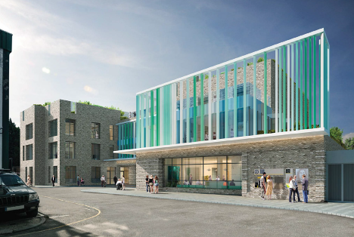
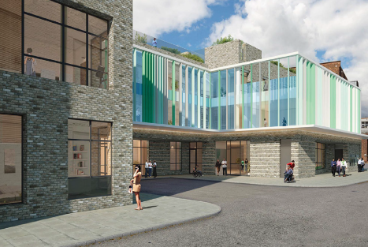
Greenwood Resource Centre, Camden
London Borough of Camden
Commercial
Education
Health and
Science
Residential
General
Works
Heritage
Value: £17.3m
The Greenwood project involves the redevelopment of 25 and 37 Greenwood Place to provide a new 3,600sq m resource and community services centre for adult social care. The project which involves the construction of a resource and community services centre for adult social care also includes therapy spaces within the CiL, hydrotherapy-pool and associated facilities and rooms, outside space, garden and roof terraces. It will comprise CiL, (Centre for independent Living) Dementia, PMLD, (Profound and Multiple Learning disabilities), Autism, Learning Disabilities and Mental health day facilities. Phase 1 also includes comprehensive highways improvements to most of Greenwood Place. Improvements to the highways flanking the Listed Church and the Music Venue (the Forum) are also to be provided as part of this phase. The second phase includes the redevelopment of the Highgate Site to provide 2,751sq m of residential development, comprising 34 private sale homes and 8 social rented units for people with social care. This also includes
a 100sq m of retail space for a Community Enterprise unit. This proposal
includes the development of Camden’s first Centre for independent Living
(CiL) promoting inclusive and independent lives for disabled and vulnerable
people enabling them to reach their full potential utilising their assets and
capabilities. This proposed centre will establish a fundamental ethos of peer
support and user led decision making, building the capacity of disabled
people to take charge of services and facilities.
"We are very lucky to be working with such as great team. Matt has worked hard to establish and maintain fantastic relationships with our many stakeholders, who have commended his approach in the way he has managed their complex needs and priorities. We are really looking forward to using the completed building later this year. . .We have found working with Kier to be really easy and would look forward to working with this team again."
Julie Farr, Senior Development Manager –
London Borough of Camden

Slide 12
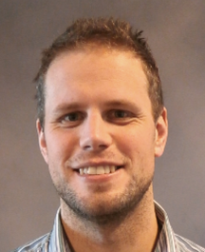
Project Management Proposals
Matt Davis
Project Manager
Kier Construction Ltd.
Notes:
Graham

Slide 13

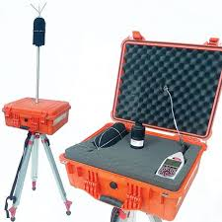
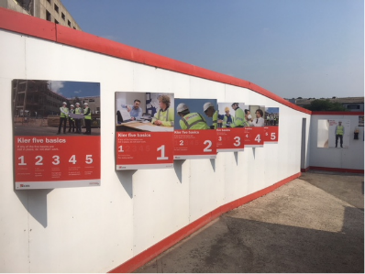
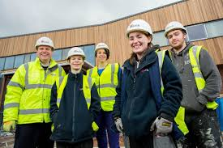
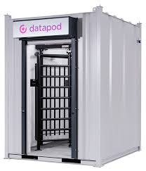


Project Management Proposals Nuisance
Noise, Dust & Vibration
Site Operative Behaviour
Visual Appearance
Security
Construction Traffic

Slide 14
Traffic Management Proposals Traffic Routing
The proposed routing avoids any unnecessary travel along residential side streets.
Cycle Quiet Ways – proposed routing avoids the need for construction vehicles to use Cale Street. Dovehouse Street use is unavoidable.
Strict adherence to the requirements of the Fleet Operators Recognition Scheme (FORS) and Construction Logistics Community Safety Scheme (CLOCS).
No deliveries accepted before 09:30 or after 16:30 to avoid peak traffic periods.
Pre-booked deliveries only – all unplanned deliveries will be prevented from turning left along Britten Street by prominently placed Traffic Marshalls.
Co-ordination will be required between Kier and Multiplex to manage the cumulative impact of both projects.

Slide 15
Traffic Management Proposals Enabling Works & Demolition
Mid-April 2019 to July 2019

Slide 16
Traffic Management Proposals Piling, Bulk Excavation & Basement
July 2019 to April 2020

Slide 17
Traffic Management Proposals Superstructure to Completion
April 2020 to April 2021

Slide 18
Construction Working Group & Next Steps
Matt Davis
Project Manager
Notes:
Graham

Slide 19
New Imaging Centre Next Steps
Agreement of Construction Traffic Management Plan with Royal Borough of Kensington and Chelsea
If you are interested in receiving a copy of our draft traffic management plan, please email matthew.davis@kier.co.uk
Deadline for receipt of construction phase comments is 3rd April 2019.
Finalise Project Communications Plan
Have your say…
    What level of information and at what frequency would you like to receive?
    What channels would you like to see used?
Please email your comments to matthew.davis@kier.co.uk by 3rd April 2019.
Formation of the Construction Working Group (CWG)
If you are interested in being a part of the group, please get in touch.
First CWG meeting anticipated in May.

Slide 20
Thank You
Any Questions?

