Slide 1


Clinical Quality Report
Month 1 – Month 3 2019-20

Slide 2
Table of contents
 | Latest headlines from NHS Model Hospital | Slide 3
Safe | Infection Prevention and Control | Slide 4
 | Incident management and reporting | Slide 5
 | NHS Safety Thermometer | Slide 5
 | Nurse staffing | Slide 6
Effective | Innovation | Slide 7
Responsive | 18 week referral to treatment target | Slide 8 - 9
 | Cancelled operations and procedures | Slide 10
 | 62 day to first treatment cancer target | Slide 11 - 13
 | 31 day cancer pathways | Slide 14
Caring | Patient experience | Slide 15 - 16
Well led | Seven Day Service | Slide 17
Performance data | Cancelled operations | Slide 19
 | Single oversight framework | Attachment

Slide 3
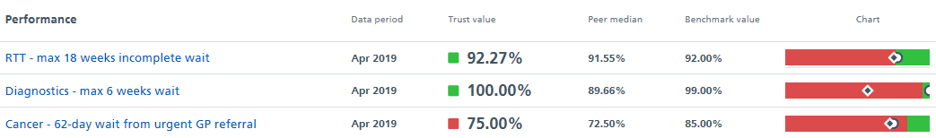
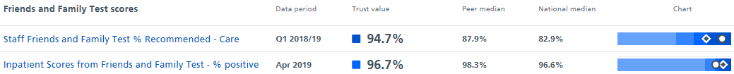
Latest headlines from NHSI Model Hospital
To note: The Trust’s position on the slider charts is marked by the white oval and the peer median is marked by the diamond
The 62 day cancer target is 66.7% for M2 and is presented in Slides 11 – 13 of this report
No MRSA bacteraemia has been reported during M1 – M3 2019-20
Where the terms ‘my peers’ or ‘peers’ are used in this it relates to Liverpool Heart and Chest NHS Foundation Trust and Royal Papworth Hospital NHS Foundation Trust

Slide 4
Safe: Infection Prevention and Control
Data owner: Lucy Everett – Matron Lead - Infection Prevention and Control and Dr Anne Hall - Consultant Microbiologist & Infection Control Doctor
Healthcare Associated Infection surveillance exceptions
During M1, an increase in the number of colonised and infected cases of carbapenem resistant Enterobacter cloacae were noted on one ward at Harefield Hospital.
Enterobacter cloacae is an organism that lives in the gut, which we can all carry. As with other organisms, Enterobacter cloacae has developed resistance to antibiotics.
Following a review and look back exercise, 7 cases were confirmed and an outbreak of infection was declared in accordance with Trust policy.
In May, supported by Public Health England (PHE), a point prevalence screening exercise was undertaken on the ward. No new cases were identified and the outbreak was closed.
Root cause
No root cause identified to date however work is ongoing.
None of the patients met the national or local criteria for screening on admission.
Actions taken
Outbreak review group set up with support from Public Health England (PHE)
Enhanced cleaning of associated clinical area undertaken
Contact tracing criteria agreed with PHE and undertaken for all 7 patients. No contact infections identified.
Point prevalence screening in clinical area is being undertaken to confirm if outbreak can be declared closed
The Trust continues to comply with the Public Health England Mandatory surveillance programme which requires reporting of incidence of the following infections:
Clostridium difficile infection surveillance
MRSA (Meticillin-resistant Staphylococcus aureus) blood stream infection (BSI)
MSSA (Methicillin-susceptible Staphylococcus aureus) BSI
E. coli BSI
Klebsiella species (BSI)
Pseudomonas aeruginosa BSI
Of the reportable infections within the surveillance programme, hospital onset C. difficile, MSSA Ecoli and Klebsiella infections have been recorded during M1-M3. These are show in the graphs along with 2018-19 rate for internal benchmarking purposes. Post infection reviews are undertaken on all infections reported and learning is shared across the organisation.

Slide 5
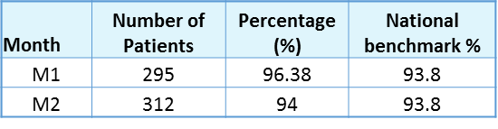
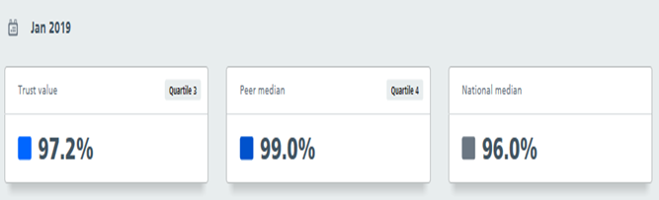
Safe: Incident management and reporting
Data owner: Penny Mortimer, Manjiri Dalvi and Eleanor Dunnett – Divisional Quality and Safety Leads
Serious incidents
One serious incident was reported during M1. The incident involved a patient attending as an out-patient. The patient fell and sustained injuries requiring treatment at a trauma centre. As a result of this incident a new handrail will be installed on the staircase between Foulis Ward and Victoria Ward at the Fulham Road site.
One serious incident was reported during M2. The incident involved an inpatient who has since died. A full investigation has been undertaken which included the involvement of the Medicines and Healthcare products Regulatory Agency (MHRA). The Trust has withdrawn the use of a piece of equipment until all investigations have concluded. As a result of this incident the Chest Drain Insertion Guidelines have been revised.
One serious incident occurred during M3. This incident relates to the failure to ensure appropriate disinfection in endoscope washer disinfector provided by an independent contractor. A comprehensive investigation is underway. The risk to patients has been identified as low, however all patients linked to the incident have been spoken to by their consultant.
Duty of Candour
Year to date, a total of 23 incidents have occurred where Duty of Candour regulations apply. As shown in the table below, Stage 1 of the Duty of Candour process has been completed for all 23 incidents. Stage 2 of the process is complete for all incidents where investigations have concluded. There are no exceptions to report.
Safe: NHS Safety Thermometer
Data owner: Peter Doyle - Divisional Lead Nurse / Associate General Manager, Harefield Hospital
The NHS Safety Thermometer was designed to measure local improvement over time and was not intended to be used to compare specific levels of harm across organisations due to the complexity and variations in patient mix. This is just one tool used by the Trust to measure harm free care and is used alongside other measures to help understand themes, analyse findings and plan improvements in care delivery. Safety Thermometer is a snapshot of care across the Trust at a given time, on a given day.
NHS Safety Thermometer is presented one month in arrears. The tables to the right show the M1 and M2 Trust level of harm free care, as recorded using NHS Safety Thermometer, and the latest, January 2019, national benchmarking included in NHSI Model Hospital.

Slide 6
Safe: Nurse staffing
Data owner: Peter Doyle - Divisional Lead Nurse / Associate General Manager, Harefield Hospital
Nurse staffing levels are presented one month in arrears to allow adequate time for the lead nurses to review month end intelligence.
The lead nurses have confirmed that where staffing levels were lower than planned this was primarily due to reduced clinical activity or reduced acuity of patients. The senior nurses confirm that no red flags, as per NICE red flag definitions, were triggered.
Where staffing levels were higher than planned this was due to higher clinical activity, higher acuity of patients or supernumerary staff such as new starters receiving orientation/training.
The Trust continues to review the Care Hours Per Patient Day (CHPPD) data, which includes information about patient activity along-side nurse staffing.
M1 and M2 nurse staffing levels Royal Brompton Hospital
M1 and M2 nurse staffing levels Harefield Hospital
% of registered nurse day hours filled as planned (Hospital) | 101.7% of planned level
% of Unregistered care staff day hours filled as planned (Hospital) | 57.4% of planned level
% of registered nurse night hours filled as planned (Hospital) | 98.4% of planned level
% of Unregistered care staff night hours filled as planned (Hospital) | 93.4% of planned level
% of registered nurse day hours filled as planned (Hospital) | 103.0% of planned level
% of Unregistered care staff day hours filled as planned (Hospital) | 55.3% of planned level
% of registered nurse night hours filled as planned (Hospital) | 100.7% of planned level
% of Unregistered care staff night hours filled as planned (Hospital) | 89.4% of planned level
% of registered nurse day hours filled as planned (Hospital) | 111.6% of planned level
% of Unregistered care staff day hours filled as planned (Hospital) | 67.6% of planned level
% of registered nurse night hours filled as planned (Hospital) | 99.0% of planned level
% of Unregistered care staff night hours filled as planned (Hospital) | 92.2% of planned level
% of registered nurse day hours filled as planned (Hospital) | 108.4% of planned level
% of Unregistered care staff day hours filled as planned (Hospital) | 68.3% of planned level
% of registered nurse night hours filled as planned (Hospital) | 92.7% of planned level
% of Unregistered care staff night hours filled as planned (Hospital) | 76.3% of planned level

Slide 7
Effective: Innovation
Data owner: Various
Beating heart mitral valve repair
A surgical team at Royal Brompton Hospital have successfully completed five ‘beating heart’ mitral valve repair operations using a pioneering treatment not offered anywhere else in England, Scotland or Wales.
The ‘NeoChord’ procedure means surgeons can repair a leaking mitral valve on a patient’s beating heart, avoiding the need for them to be put on a heart-lung bypass machine. This means the procedure is suitable for patients with a high risk of developing complications, or who are too unwell to have their heart stopped and re-started with cardiopulmonary bypass. The NeoChord device is inserted into the heart through a small cut in the left chest and navigated to the leaking part of the mitral valve using continuous real-time trans-esophageal echocardiography (TOE).
Overall, 17 patients have been treated with NeoChord at Royal Brompton and the team have welcomed visiting cardiac surgeons and cardiologists from other centres such as University Hospital Galway, Ireland, and King’s College Hospital, London.
Ms Rashmi Yadav, the consultant cardiac surgeon who led the team performing the procedures, said: “Patients can expect to go home within three to four days. As the procedure is significantly less invasive than conventional surgery, it offers a new treatment option to patients who may otherwise be denied surgery or who risk complications from the procedure. Planning and team work are imperative for the success of these innovative procedures and the input of dedicated surgical, anaesthetic and operating theatre colleagues is absolutely critical, especially when working on new techniques. I feel extremely fortunate to have such a committed and talented team here at Royal Brompton.”
The ‘perfect week’
Following the success of last year’s ambitious “Perfect Week”, Harefield Hospital teams have run a similar week-long programme to help better understand the delays patients experience while moving through, or out of the hospital.
Supported by the Darwin programme, teams tracked each patient’s journey in detail, with a focus on critical care and ward areas. The aim was to gather evidence and identify issues that cause delays.
This year’s programme focused on identifying any recurring themes that affect inpatient flow in order to inform future Darwin work. The divisional team devised a set of patient flow standards which were audited on the wards during the week.
A review of the main themes that emerged is underway and teams plan to work collaboratively to try and resolve issues that were identified as causing delays.

Slide 8
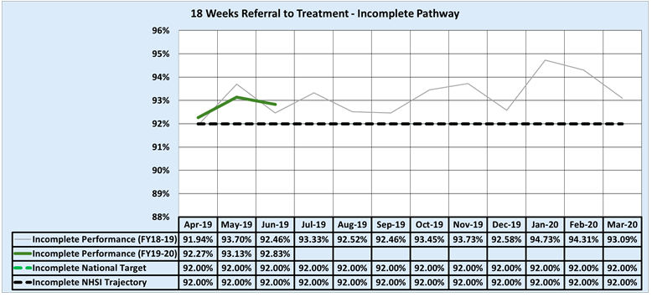
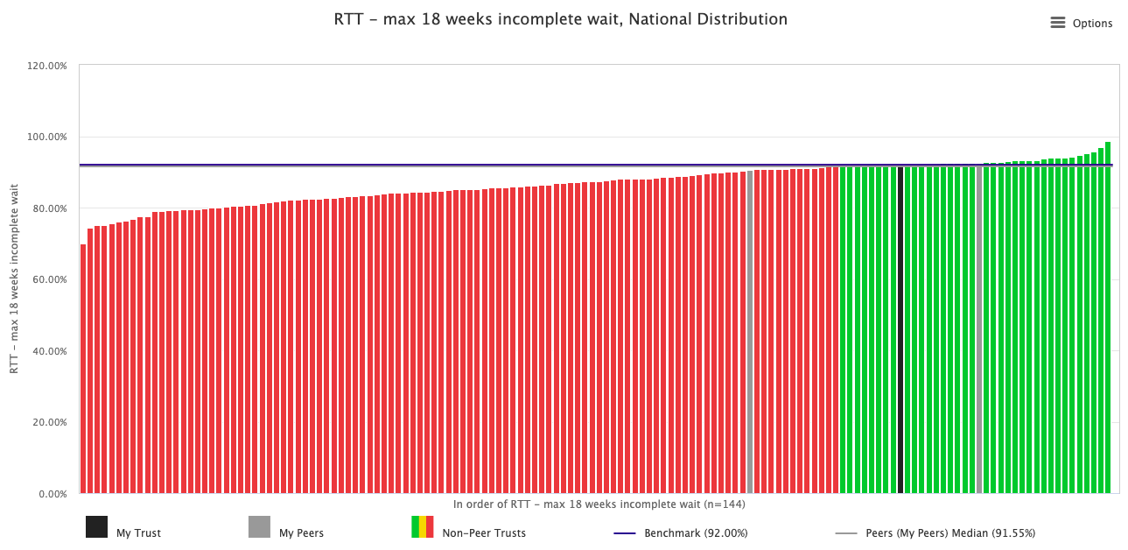

Responsive: 18-week referral to treatment time targets
Data owner: Derval Russell – Harefield Hospital Director and Ross Ellis – Royal Brompton Hospital Director
M1-M3 incomplete pathway performance
April 2019 NHSI Model Hospital benchmarking against NHS England trusts
M3 data is provisional
M1-M3 incomplete pathway performance
During M1-M3 one patient waited longer than 52 weeks for treatment
Root Causes
The patient was out of the country for a 5-month period delaying the required diagnostics however, the Trust missed several opportunities to stop this patient’s pathway and refer the patient back to the GP. In addition, there were internal delays along the pathway and delayed decision points which again prolonged the patient’s pathway.
Mitigating actions
Operational actions:
The 18-week team lead and the ICC Administrator are now meeting weekly to review patient pathways and identify and address any issues.
ICC outpatient capacity has been increased with a new weekly full day clinic which will reduce the time form referral to first OP appointment.
Corporate actions:
The issue as to whether ICC Screening should be exempt from RTT is being discussed with NHS Improvement during their next visit to the Trust.

Slide 9
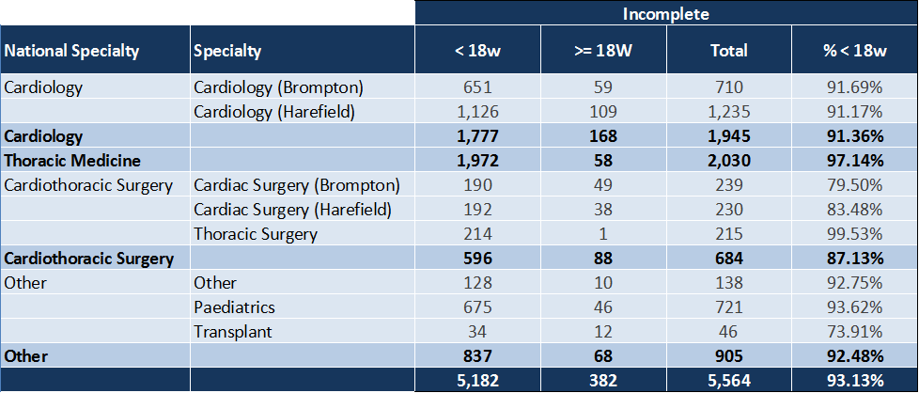
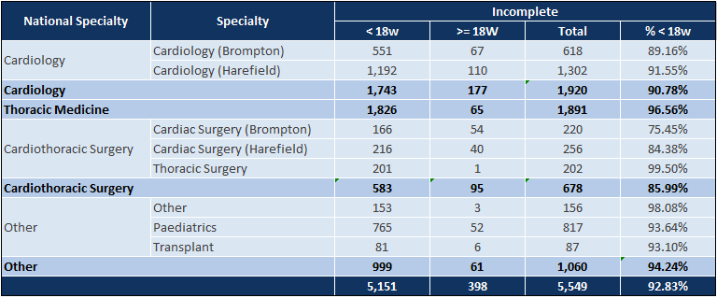
Responsive: 18-week referral to treatment time targets
Data owner: Derval Russell – Harefield Hospital Director and Ross Ellis – Royal Brompton Hospital Director
M1 incomplete pathways by speciality
M2 incomplete pathways by speciality
M3 incomplete pathways by speciality - provisional

Slide 10
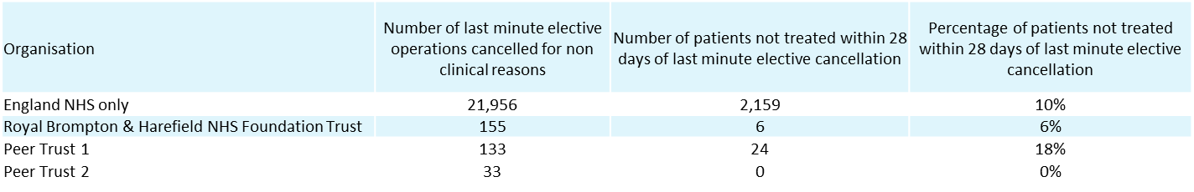
Responsive: Cancelled operations and procedures
Data owner: Derval Russell – Harefield Hospital Director and Ross Ellis – Royal Brompton Hospital Director
During M1-M3 123 patients had their operation or procedure cancelled for non clinical reasons. 120 patients had their surgery or procedure within 28 days of cancellation, however for three patients this was not possible.
Patient 1: | NHS Gloucestershire CCG (11M) | The patient’s complex surgery required two specialist surgeons and the initial date of surgery was cancelled due to one surgeon being unavailable. The patient underwent surgery on day 35 post cancellation and is due to be discharged home shortly. The management team have reviewed internal processes and have taken action to help ensure that a similar incident does not reoccur.
Patient 2: | NHS Brent CCG 07P | The second, specialist surgeon required for this procedure was currently unavailable due to injury. Surgery is scheduled for July 17th. Patient harm is not anticipated.
Patient 3: | NHS Enfield CCG 07X | A complex operation in theatres overran resulting in this patient’s surgery being rescheduled. The patient underwent surgery on July 8th.
Year to date data for cancelled operations is shown in slide 19 of this report.
The table to the right shows Q4 data published by NHS Digital benchmarked against all NHS England trusts and Liverpool Heart and Chest Hospital NHS Foundation Trust and Royal Papworth Hospital NHS Foundation Trust.
Responsive: Six week diagnostic waits
Data owner: Christine Peacock – Radiology Service Manager, Royal Brompton Hospital and Juliette Tennant – Imaging Service Manager, Harefield Hospital
Diagnostic waiting times form part of the NHS Constitution. The NHS Constitution gives patients the right to treatment within 18 weeks of referral and as part of this, pledges that patients should not be required to wait six weeks or longer for a diagnostic test.
It has been confirmed that four patients waited longer than 6 weeks for diagnostic procedures during May 2019 (M2).
Patient 1: An ultrasound scan was not booked in a timely manner due to administrative oversight. The scan has since been undertaken and the results were determined to be normal.
The remaining three patients were not sent an appointment for a CT scan due to an error in the electronic requesting system. All patients underwent a CT scan within 6 weeks + 5 days. Each patient has undergone a consultant review and, in each case, it has been determined that the impact of the delays was negligible.
Each of the above breaches have been fully investigated by the service managers and actions have been taken to help prevent similar incidents from reoccurring.

Slide 11
Responsive: 62 day urgent GP referral to first treatment cancer target M12 - 2018/19
Data owner: John Pearcey – Assistant General Manager, lung division
The cancer performance date presented in slides 11-14 was accurate at the time of reporting. Referring Trusts are able to edit data within NHS Digital after the publication date. Changes made by referring trusts may impact in the Trust.
The Trust continues to find it challenging to meet the 62-day urgent GP referral to first treatment target.
Action being taken during 2019-20 to improve performance includes:
The Trust will review the quarterly, revalidated NHS Digital figures and proactively use this intelligence to inform discussions with commissioners and referring Trusts.
The NHS Digital revalidated figures will also be incorporated into intelligence presented to the Operational Management Team and to Trust Board.
The responsible officer and senior management team within the Lung Division will continue to examine and test options available to help ensure pathways are closed in a more timely manner. Performance against this will be presented quarterly to the Operational Management Team.
 | Published Figures
Month | Total Seen/Treated | Total Accountable | Total Compliant | Total Breached | Unadjusted Performance (Target 85%)
M12 2018-19 | 13 | 7.0 | 3.0 | 4.0 | 42.9%
M1 2019-20 | 10 | 5.5 | 3.5 | 2 | 63.6%
M2 2019-20 | 6 | 3 | 2 | 2 | 66.7%
Commentary for the above breaches is located on slides 12 and 13.
The graph below shows the total number of 62 day urgent GP referrals for surgery for cancer and demonstrates the allocation of breaches.
NHS England nationally published 62 day performance
62 day performance for April 2019 across all cancers and all modality types = 79.4%
62 day performance for April 2019 across lung cancer only, however across all modality types (cannot delve further than that) = 66.4%

Slide 12
Responsive: 62 day urgent GP referral to first treatment cancer target M12 - 2019/20
Data owner: John Pearcey – Assistant General Manager, lung division
M12: 62 days to 1st Treatment
13 new patients were seen and treated during M12. 6 of these patients received their treatment within 62 days of their GP referral.
The pathways for remaining 7 patients breached the 62-day GP referral to treatment target and, at present, the Trust has shared or full responsibility for 3 of these breaches. Each breach is undergoing a full investigation with the referring Trust and the breach allocation may be revised as a result of the findings of the investigation. An initial overview of the breach is shown below.
Patient 2: Patient referred at day 43, required further investigations including VQ scan and subsequent MDT discussion. Had surgery with no complication.
Patient 4: Patient referred at day 30 however required several tests, including tests for a different clinical condition, which needed to be completed before lung surgery could be offered.
Patient 6: Patient referred on day 59 and wanted to consider treatment options. With clinical support, surgery was confirmed as the best option. Procedure was successful and patient was discharged home.
Referring Trust and Hospital | Day of referral received by RBHT | Number of Days from receipt of referral at RBHT to treatment | Number of days from GP referral to treatment | Breach Allocation
(1) Heatherwood And Wexham Park Hospitals NHS Foundation Trust Wexham Park Hospital | 85 | 13 | 98 | 100% of breach allocated to referring Trust
(2) Buckinghamshire Healthcare NHS Trust Wycombe Hospital (NHS Buckinghamshire CCG 14Y) | 43 | 39 | 82 | Shared Breach NHSE breach code 7 Complex diagnostic pathway
(3) Luton And Dunstable Hospital NHS Foundation Trust Luton And Dunstable Hospital | 57 | 14 | 71 | 100% of breach allocated to referring Trust
(4) East And North Hertfordshire NHS Trust Hertford County Hospital | 30 | 87 | 117 | 100% of breach allocated to RBHT NHSE breach code 7 Complex diagnostic pathway
(5) West Hertfordshire Hospitals NHS Trust Hemel Hempstead Hospital | 57 | 17 | 74 | 100% of breach allocated to referring Trust
(6) East And North Hertfordshire NHS Trust Lister Hospital (NHS East and North Hertfordshire CCG 06K) | 59 | 35 | 94 | Shared Breach NHSE breach code 7 Complex diagnostic pathway
(7) West Hertfordshire Hospitals NHS Trust Hemel Hempstead Hospital | 60 | 16 | 76 | 100% of breach allocated to referring Trust

Slide 13
Responsive: 62 day urgent GP referral to first treatment cancer target M1 and M2 2019/20
Data owner: John Pearcey – Assistant General Manager, lung division
10 new patients were seen and treated during M1. 6 of these patients received their treatment within 62 days of their GP referral.
The pathways for remaining 4 patients breached the 62-day GP referral to treatment target and, at present, the Trust has shared responsibility for 2 of these breaches. Each breach is undergoing a full investigation with the referring Trust and the breach allocation may be revised as a result of the findings of the investigation. An initial overview of the breaches for which the Trust has shared responsibility is shown below:
Patient 1: Patient referred on day 70 of the pathway as required several investigations prior to referral. Patient required further imaging once referred to RBH for surgery.
Patient 2: Patient had complex clinical needs and required a plastic surgeon to be present during the procedure. Previous scheduled dates had to be cancelled due to the availability of a plastic surgeon which elongated the pathway. Patient has been seen in follow up clinic having undergone a successful complex procedure.
6 new patients were seen and treated during M2. 4 of these patients received their treatment within 62 days of their GP referral.
The pathways for remaining 2 patients breached the 62-day GP referral to treatment target and, at present, the Trust has shared responsibility for 1 of these breaches and full responsibility for 1 breach.
Patient 1: Patient was referred to the Trust on the 31 day to subsequent treatment pathway and underwent surgery on day 30. However, due to data submitted to NHS digital by the referring trust, this patient pathway is currently showing as a 62 day breach. A full breach review is currently being undertaken with the referring trust.
Patient 2: A complex operation in theatres overran resulting in this patient’s surgery being rescheduled. A full review has been undertaken by the local clinical team and a breach review has been undertaken.
Referring Trust and Hospital | Day of referral received by RBHT | Number of Days from receipt of referral at RBHT to treatment | Number of days from GP referral to treatment | Breach Allocation and NHS England breach classification
Croydon Health Services NHS Trust Croydon University Hospital (NHS Croydon CCG 07V) | 144 | 30 | 174 | Shared breach NHSE breach code 7 Complex diagnostic pathway
(2) Buckinghamshire Healthcare NHS Trust Wycombe Hospital (NHS Buckinghamshire CCG 14Y) | 35 | 30 | 65 | 100% of breach allocated to RBHT NHSE breach code 4 Elective cancellation (for non-medical reason) for treatment in an admitted care setting
Referring Trust and Hospital | Day of referral received by RBHT | Number of Days from receipt of referral at RBHT to treatment | Number of days from GP referral to treatment | Breach Allocation
Great Western Hospitals NHS Foundation Trust The Great Western Hospital (NHS Wiltshire CCG 99N) | 70 | 39 | 109 | Shared breach NHSE breach code 7 Complex diagnostic pathway
(2) The Royal Marsden NHS Foundation Trust The Royal Marsden Hospital (London) (NHS Guilford and Waverley CCG 09N) | 46 | 112 | 158 | Shared breach NHSE breach code 5 Elective capacity
(3) West Hertfordshire Hospitals NHS Trust Hemel Hempstead Hospital | 79 | 10 | 89 | 100% of breach allocated to referring Trust
(4) The Hillingdon Hospitals NHS Foundation Trust Hillingdon Hospital | 47 | 20 | 67 | 100% of breach allocated to referring Trust

Slide 14
Responsive: 31 day cancer pathway targets
Data owner: John Pearcey – Assistant General Manager, lung division
31 day to first definitive treatment waiting time standard
31 day to subsequent treatment waiting time standard
The 31 day to definitive treatment cancer waiting time standard relates to the period of time between the Decision to Treat (DTT) date and the date of the start of the First Definitive Treatment (FDT).
The Decision To Treat (DTT) date is the date the patient agrees a treatment plan, i.e. the date that a consultation between the patient and the clinician took place and a Planned Cancer Treatment was agreed.
The First Definitive Treatment is normally the first intervention which is intended to remove, debulk or shrink the tumour.
A total of 62 patients were treated on the 31 day to definitive treatment cancer pathway during M1 and M2. One of these patients was not treated within 31 day cancer waiting time standard.
This is the same patient as Patient 2 in the M1 62 day breach section – both cancer waiting time standards were breached due to the lack of an available plastic surgeon.
NHS England delay in treatment code - (5) Elective capacity inadequate (patient unable to be scheduled for treatment within standard time) for treatment in an admitted care setting
The 31 day to subsequent treatment waiting time standard applies to all subsequent treatments for primary and recurrent cancer and covers follow on treatments that are directly related to shrinking or delaying growth/spread of the cancer.
Treatments such as closure of stomas, reconstructive surgery following initial surgery, rehabilitative and psychological services are not included within this waiting time standard.
Subsequent treatments can either start with a Decision To Treat (DTT) date or the earliest date that it is clinically appropriate for that treatment to take place (ECAD).
A total of 33 patients were treated on the 31 day to subsequent treatment cancer pathway during M1 and M2. Three of these patients were not treated within 31 days.
Patient 1: Patient was due to be admitted in time, however surgery was cancelled by the plastic surgeon due to capacity issues. Patient was treated on day 88. NHS England delay in treatment code – (97) Other reason (not listed)
Patient 2: Patient choice. NHS England delay in treatment code – (16) Patient choice
Patient 3: Capacity issues prevented this patient being treated within 31 days due to capacity issues and was treated on day 31. NHS England delay in treatment code - (5) Elective capacity inadequate (patient unable to be scheduled for treatment within standard time) for treatment in an admitted care setting
 | Published Figures
 | Total Seen/Treated | Total Accountable | Total Compliant | Total Breached | Performance (Target 96%)
Mar | 40 | 40 | 40 | 0 | 100.0%
Apr | 34 | 34 | 33 | 1 | 97.1%
May | 28 | 28 | 28 | 0 | 100.0%
 | Published Figures
 | Total Seen/Treated | Total Accountable | Total Compliant | Total Breached | Performance (Target 94%)
Mar | 12 | 12 | 12 | 0 | 100.0%
Apr | 17 | 17 | 15 | 2 | 88.2%
May | 16 | 16 | 15 | 1 | 93.8%

Slide 15
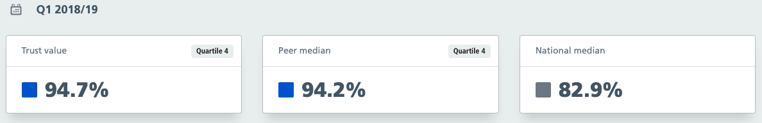
3.1 Caring: Patient experience
Data owner: Karen Taylor - Patient & Public Engagement and Sharon Gurney - Complaints Manager / PALS lead
Friends and Family Test
Complaints
Due to national turnaround times of the Friends and Family Test (FFT) results performance will be presented one month in arrears
The Trust received 20 new complaints during M1-M3. All were acknowledged within 3 working days.
All complaints closed during M1-M3 were closed within the timescale agreed with the complainant.
Friends and Family Test – inpatients and day case | M01 | M02
Eligible Patients | 3030 | 3332
Number of responses from eligible patients | 1071 | 1194
Trust FFT response rate | 35.5% | 35.8%
Trust recommendation score for FFT | 96.8% | 95.9%
Negative responses | 20 | 16
All Comments | 802 | 872
Positive comments | 789 | 849
Negative comments | 14 | 8
Complaints received during M1-M3 include concerns about:
Availability of information about after effects of surgery
Waiting times
Staff attitude
Actions being taken as a result of complaints received during M1-M3:
The benchmark table below shows Q1 comparative intelligence from NHS Model Hospital
Education | Communication
Mental Health Act training Palliative care teaching on ward study days to highlight the on call service | Written information given to patients before procedures is being reviewed Aminoglycoside consent form is being reviewed and updated
Listening to patients and actions
2 negative FFT inpatient comments have been followed up by staff to investigate further. The outcome will be reported in M4 CQR
In response to comments received on the temperature, air conditioning units have been installed on Lind DCU to combat the heat/hot weather. This is proving popular with patients
A new microwave is likely to be installed on Rose/Fir Wards for long-stay patients. A working group (infection control, Matron and ISS) has been set up to ensure patient safety relating to the introduction of a microwave

Slide 16
3.1 Caring: Patient experience
Data owner: Karen Taylor - Patient & Public Engagement
2018 CQC Adult Inpatient Survey
This annual survey examined the whole patient journey from admission through to discharge, providing a comprehensive review of the patient experience locally and nationally. It was sent to a sample of 1,250 RBHT patients that stayed at least one night in July 2018. 453 (35%) eligible patients returned the completed questionnaire. Of the respondents, 71% reported they lived with a chronic condition and 47% were aged 70+.
The results were released by CQC in June 2019 with both hospitals performing ‘better than expected’. The Trust scored better than average on most of the questions. Key achievements include:
96% of patients overall felt they were treated with dignity and respect
96% had confidence and trust in the doctors treating them
94% had confidence and trust in the nurses and other clinical staff treating them
92% had confidence in the decisions being made about their care or treatment
96% felt the staff caring for them work well together
92% felt they were given enough information about their condition or treatment
94% felt they had any questions answered in a way they could understand, before an operation or procedure
Over 90% or respondents felt they were given enough privacy for discussion around their condition and treatment and when being examined or treated
92% felt they did not have to wait a long time to get a bed on a ward
Nearly 90% overall felt they had a good experience.
CQC 2018 Biannual Children & Young People’s Survey
Data collection completed at the end of April 2019 and results from CQC are expected in “Spring” 2020.
2019 Pilot Children & Youth People’s Survey
The Trust is taking part in an additional pilot project this year to test the response rates to the questionnaire via letter and SMS communications with patients. It is expected to provide some additional useful data on young people’s experiences at the Trust.
Over the next 12 months the Patient and Public Engagement Team will create an action plan to address some identified areas for improvement including:
Awareness of the variety channels for patients to feedback (including FFT, AIPS, PALS compliments, concerns and complaints) as well as local surveys (to address low response rate and lack of knowledge)
Raising awareness of the holistic support available to patients (to alleviate fear and worries)
Supporting patient and family involvement in decisions on care and treatment
Improvements to discharge

Slide 17
3.1 Well led: Seven Day Service
Data owner: Penny Agent - Director of Allied Clinical Sciences
The ‘Seven Day Hospital Services Programme’ (7DS) was developed to support providers of acute services to deliver high quality care and improve outcomes on a seven-day basis for patients admitted to hospital in an emergency. In November 2018 NHS England and NHS Improvement introduced a new board assurance framework measurement template for seven day hospital services, replacing the previous self-assessment survey.
The measurement template lists the four priority 7DS clinical standards (standards 2, 5, 6 and 8). The outcome of the Trust’s assessment is shown below:
The Board assurance framework measurement template also captures detail on 7DS in urgent network specialist services with regard to the four priority 7DS clinical standards:
Hyperacute stroke (not applicable to RBHFT)
Paediatric intensive care
STEMI heart attacks
Major trauma (not applicable to RBHFT)
Emergency vascular services
Clinical standard | Weekday | Weekend | Overall Score
2 – time to 1st cons review | met | met | Standard met
5 – diagnostic services | met | met | Standard met
6 - interventions | met | met | Standard met
8 – consultant review | Once daily - met | Once daily - met | Standard met
Performance against the 4 priority standards for urgent network clinical services has been assessed with results as follows. In summary:
For clinical standard 5 ‘Access to Diagnostics’: the Trust provides 5 of 6 consultant directed diagnostics (CT, echocardiograph, microbiology, MRI, ultrasound, upper GI) on-site or by formal arrangement seven days week except CMR (MRI) at weekends.
To improve access the CMR unit has extended day (12 hours) services which started July 2017 (Mondays – Fridays) and Saturday working was introduced January 2019 to accommodate long waiting lists.
CMR is not available on Sundays. However, as 5 of the 6 diagnostics are available 7 days a week the standard overall has been met.
Clinical Standard | Paediatric Intensive Care | STEMI Heart Attack | Emergency Vascular Services | Comment
2 | met | met | met
5 | met | met | met
6 | met | met | met
8 | met | met | met | Improvement since spring 2018 where the standard was not met for emergency vascular services. This has been audited and is now met at both sites.
As shown above, the Trust fully meets each of the 4 priority clinical standards. In addition, the Trust has demonstrated that once a clear patient pathway has been established, 100% of patients received once daily consultant reviews (100% on weekdays and 100% at weekends)

Slide 18
Additional Performance Data

Slide 19
Responsive: Cancelled operations and procedures
Data owner: Derval Russell – Harefield Hospital Director and Ross Ellis – Royal Brompton Hospital Director

