Slide 1


Clinical Quality Report
Month 6 and Month 7 2019-20

Slide 2
Table of contents
 | Latest headlines from NHS Model Hospital | Slide 3
Safe | Infection Prevention and Control | Slide 4 - 5
 | Sepsis | Slide 5
 | Surgical site infections | Slide 6
 | Incident management and reporting | Slide 7
 | NHS Safety Thermometer | Slide 7
 | Nurse staffing | Slide 8
Responsive | 18 week referral to treatment target | Slide 8 - 9
 | Cancelled operations and procedures | Slide 9
 | 62 day to first treatment cancer target | Slide 9 - 10
 | 31 day cancer pathways | Slide 11
Caring | Patient experience | Slide 12
Effective | Cystic Fibrosis clinical trials | Slide 13
Well Led | The Sunflower Scheme | Slide 13
 | Your Heart Hospital | Slide 14
 | Rainbow badges | Slide 14
Performance data | Cancelled operations | Slide 16
 | Single oversight framework | Slide 17 - 18
For information | Cancer pathways diagram | Slide 19

Slide 3
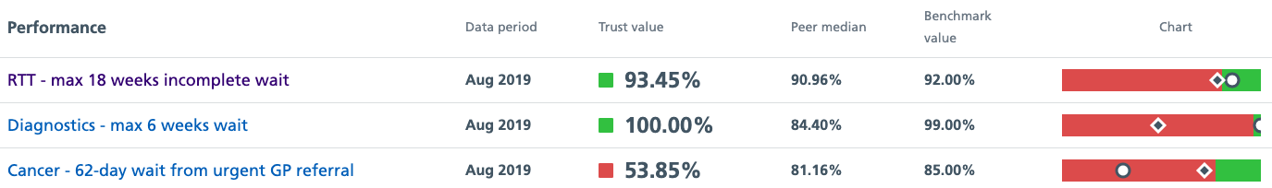
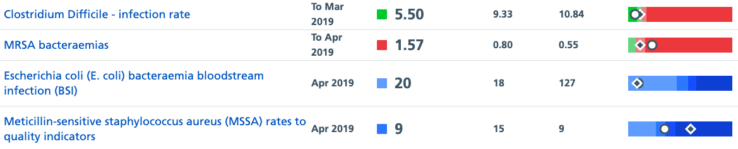
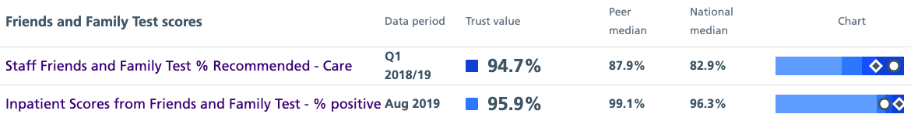
Latest headlines from NHSI Model Hospital
To note: The Trust’s position on the slider charts is marked by the white oval and the peer median is marked by the diamond
NHS Digital quarterly revalidation of cancer data is underway and finalised Q1 and Q2 data will be available later in the year.
One MRSA bacteraemia has been reported during 2019-20
Where the terms ‘my peers’ or ‘peers’ are used in this it relates to Liverpool Heart and Chest NHS Foundation Trust and Royal Papworth Hospital NHS Foundation Trust

Slide 4
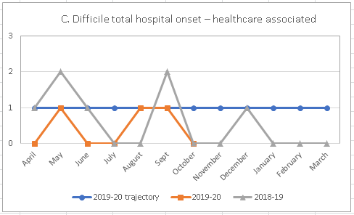
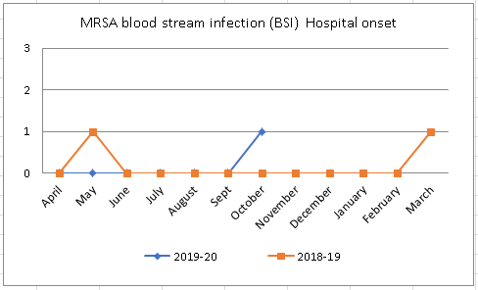
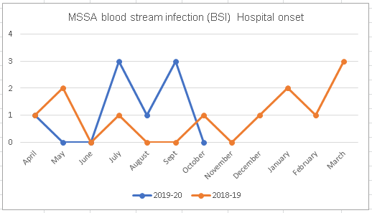
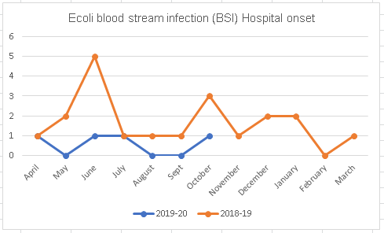
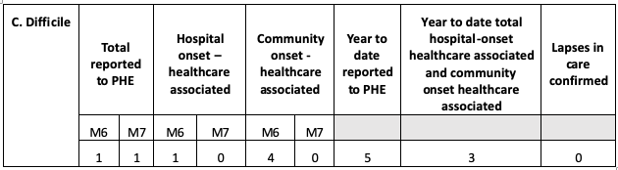
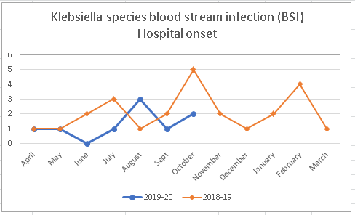
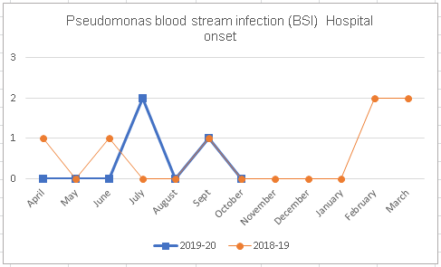
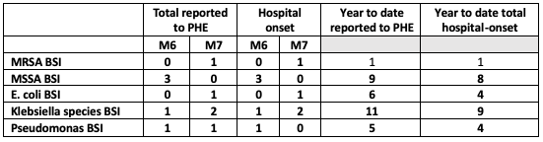
Safe: Infection Prevention and Control
Data owner: Lucy Everett – Matron Lead - Infection Prevention and Control
The Trust continues to comply with the Public Health England Mandatory surveillance programme which requires reporting of incidence of the following infections:
Clostridium difficile infection surveillance
MRSA (Meticillin-resistant Staphylococcus aureus) blood stream infection (BSI)
MSSA (Methicillin-susceptible Staphylococcus aureus) BSI
E. coli BSI
Klebsiella species (BSI)
Pseudomonas aeruginosa BSI
The graphs below show the hospital onset infection rates for the infections reportable under the Public Health England Mandatory surveillance programme, alongside 2018-19 hospital onset infection rates for internal benchmarking purposes.
The tables below show the M6 – M7 and year to date position for infections within the surveillance programme. Post infection reviews are undertaken on all infections reported and learning is shared across the organisation.
Outcome of C. difficile review with NHS England and Improvement
The post infection review of the C. difficile toxin (CDT) positive case which occurred during Q1 has been completed. This was undertaken in partnership with NHS England and no lapses in care were identified. The review also confirmed that the patient was isolated and treated promptly.

Slide 5
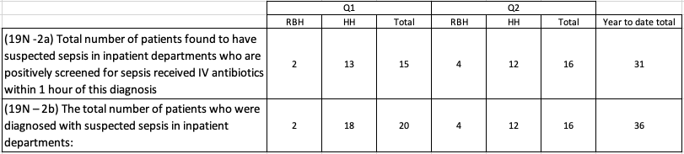
Safe: Infection Prevention and Control
Data owner: Lucy Everett – Matron Lead - Infection Prevention and Control and Dr Anne Hall - Consultant Microbiologist & Infection Control Doctor
The Matron lead for Infection Prevention and Control and the Consultant Microbiologist & Infection Control Doctor confirm that there were no outbreaks of infections or areas of concern to report during M6.
During October a meeting was held with Public Health England (PHE) after the IPC team had become aware of an increased incidence (more the 2 cases associated in time and place) of Elizabethkingia miricola. The organism was isolated in bronchoalveolar lavage samples from three patients on AICU during August, September and October. In conjunction with PHE, it was agreed that an outbreak of infection did not need to be declared; however, the investigation and surveillance continues.
Compliance with key elements of the Infection Prevention and Control Policy during M7 is shown in the table on the right.
Infection Prevention and Control (IPC) Training
There was a focused drive to improve IPC mandatory training compliance in October. At the time of writing compliance was 81%. The IPC team will continue this work over the coming months to target teams that remain below 95% and increase the compliance level further.
Safe: Sepsis
Data owner: Caterina Vlachou – Consultant Anaesthetist RBH ITU and Peter Doyle - Divisional Lead Nurse / Associate General Manager, Harefield Hospital
The table in this section of the report details the Trust’s performance against the contractual sepsis metrics during Q1 and Q2. As the table shows, a total of 36 patients were diagnosed with suspected sepsis in inpatient departments and 31 of these patients received intravenous (IV) antibiotics within one hour of being positively screened for sepsis.
Of the five patients who did not receive antibiotics within 1 hour:
One patient had recently received intravenous antibiotics;
Two patients had a cardiac emergency that took priority;
The care of the remaining two patients is currently being reviewed.

Slide 6
Safe: Surgical site infections (SSI)
Data owner: Melissa Rochon – Quality and Safety Lead for Surveillance
Public Health England leads the national Surgical Site Surveillance (SSI) programme. The surveillance programme looks at infections linked to defined surgical procedures.
The Trust submits data to the surveillance programme for those procedures undertaken at the Royal Brompton Hospital and Harefield Hospital.
In addition to participating in the national surveillance programme, the Trust also has an active, prospective in-house surveillance service.
The Trust maintains SSI rates that are much lower than national SSI rates:
Trust coronary artery bypass graft (CABG) October 2018 – September 2019 SSI rate is 1.8%. This is lower than the Public Health England (PHE) benchmark of 3.3%.
The Trust cardiac (non-CABG) October 2018 – September 2019 SSI rate is 0.5%. This is lower than the PHE cardiac (non-CABG) SSI rate of 1.3%.
During October 2018 – September 2019 one SSI was detected following the 241 paediatric cardiac surgery procedures undertaken and included in the surveillance programme.
The graphs included in this section of the report show, by rolling year, the number of relevant procedures undertaken by month and the number of surgical site infections detected and reported to the national surveillance programme.

Slide 7
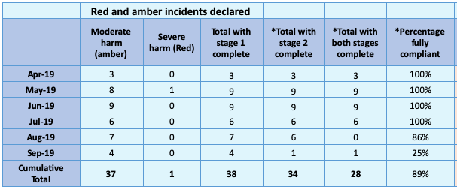
Safe: Incident management and reporting
Data owner: Penny Mortimer, Manjiri Dalvi and Eleanor Dunnett – Divisional Quality and Safety Leads
Serious incidents
The divisional quality leads have confirmed that no serious incidents were reported during M6 and that one Never Event was reported during M7.
The Never Event has been reported to NHS England and is currently undergoing a full investigation. Duty of Candour requirements have been met and the patient has been discharged home.
Learning from incidents reported during Q2 have resulted in a number of areas for improvement including:
Documentation for recording pre-existing wounds has been updated;
A surgical site infection e-module is planned for 2020;
Raising awareness of the importance of glucose pre-operative checks for patients with diabetes has been undertaken;
Pre-operative glucose monitoring spot checks will be carried out throughout the year.
Duty of Candour
Year to date, a total of 38 incidents have occurred where Duty of Candour regulations apply. This is an adjustment on previous reports and is a result of a number of incidents having been downgraded following investigation. Patients were kept fully briefed.
As shown in the table below, Stage 1 of the Duty of Candour process has been completed for all 38 incidents. Stage 2 of the process is complete for all incidents where investigations have concluded. There are no exceptions to report.
Safe: NHS Safety Thermometer
Data owner: Peter Doyle - Divisional Lead Nurse / Associate General Manager, Harefield Hospital
The NHS Safety Thermometer was designed to measure local improvement over time and was not intended to be used to compare specific levels of harm across organisations due to the complexity and variations in patient mix. This is just one tool used by the Trust to measure harm free care and is used alongside other measures to help understand themes, analyse findings and plan improvements in care delivery. Safety Thermometer is a snapshot of care across the Trust at a given time, on a given day.
NHS Safety Thermometer is presented one month in arrears. The table to the right shows year to date level of harm free care across the Trust and demonstrates that the level of harm free care is greater than the national average, as recorded using NHS Safety Thermometer.

Slide 8
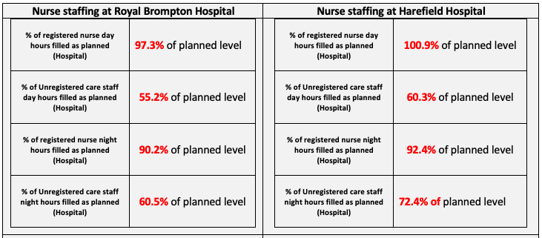
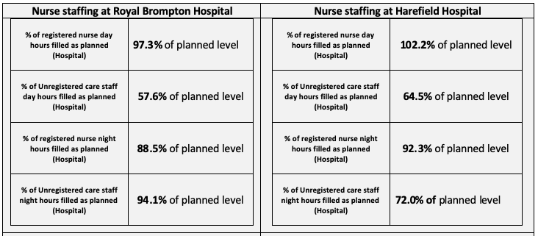
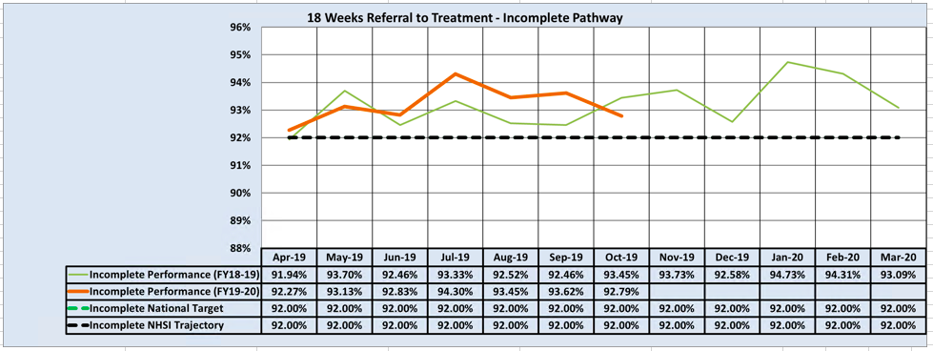
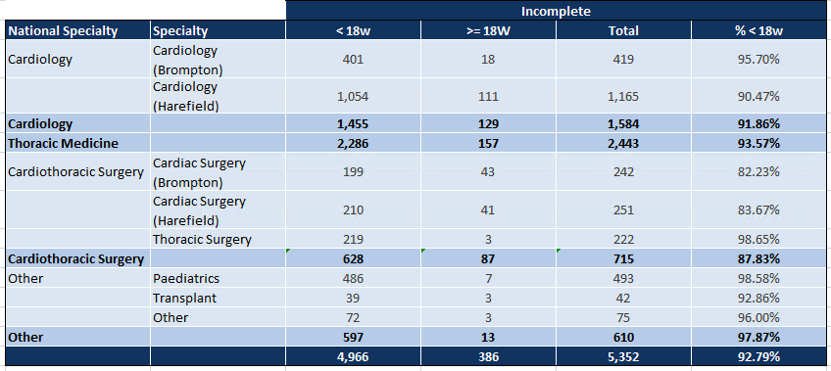
Safe: Nurse staffing
Data owner: Peter Doyle - Divisional Lead Nurse / Associate General Manager, Harefield Hospital
The senior nurses confirm that safe staffing levels were maintained and that no red flags, as per NICE red flag definitions, were triggered during M5 or M6. The lead nurses report that where registered nurse fill levels are higher than planned this is due to the acuity of patient needs and due to supernumerary staff, such as new starters. Where fill rates are lower than planned this is primarily due to bed occupancy being lower than anticipated.
Fill levels for non-registered nurses are consistently lower than planned. This staff group is small in number and includes a diverse range of roles, most of which are tailored specifically for a particular clinical area, and many of which are support roles. They are difficult to recruit to, and there are limited options for finding appropriate temporary cover. Vacant roles may put increase pressure on other staff, but do not present a safety issue.
The Trust continues to review Care Hours Per Patient Day (CHPPD) data, which includes information about patient activity, along-side nurse staffing.
Responsive: 18-week referral to treatment time targets
Data owner: Derval Russell – Harefield Hospital Director and Ross Ellis – Royal Brompton Hospital Director
M7 Incomplete pathway performance

Slide 9

Responsive: 18-week referral to treatment time targets
Data owner: Derval Russell – Harefield Hospital Director and Ross Ellis – Royal Brompton Hospital Director
M6 Incomplete pathway performance
52 week pathway breaches
During M6 one patient continued to wait longer than 52 weeks for treatment. This patient has now been referred back to their GP. The root cause of this breach was reported in M1-M3 CQR along with mitigating actions.
Responsive: Cancelled operations and procedures
Data owner: Derval Russell – Harefield Hospital Director and Ross Ellis – Royal Brompton Hospital Director
During M6 37 patients had their operation or procedure cancelled for non clinical reasons and during M7 55 patients had their operation or procedure cancelled for non clinical reasons. All patients underwent their surgery or procedure within 28 days of cancellation. Year to date data for cancelled operations is shown in slide 16 of this report.
Responsive: 62 day urgent GP referral to first treatment cancer target
Data owner: John Pearcey – Assistant General Manager, lung division
The cancer performance data presented in slides 9-11 was accurate at the time it was report to NHS Digital. Referring trusts are able to edit data within NHS Digital after the publication date and changes made by referring trusts may impact on the Trust’s reporting and performance. Data published by NHS England Model Hospital (Slide 3) may reflect changes made by referring Trusts. NHS Digital publish revalidated cancer data at key points throughout the year. Once this the revalidated data is available the data in these slides will be adjusted accordingly.
As the table on the next slide shows, during M5, 15 patients were seen and treated on a 62 day urgent GP referral to first cancer treatment pathway. 7 of these patients were seen and treated within 62 days and 8 patients received their treatment after 62 days. Of the 8 patient pathways breaching the 62 day target, 4 of the breaches were partially attributed to the Trust and 1 was fully attributed to the Trust. A review of pathway breaches attributed to the Trust has been undertaken. The Trust’s cancer lead has confirmed that all breaches related to the complexity of the patients being treated.
During during M6, 12 patients were seen and treated on a 62 day urgent GP referral to first cancer treatment pathway. 9 of these patients were seen and treated within 62 days and 3 patients received their treatment after 62 days. Of the 3 patient pathways breaching the 62 day target, 1 of the breaches were partially attributed to the Trust and 1 was fully attributed to RBHT. A review of pathway breaches attributed to the Trust has been undertaken. The Trust’s cancer lead has confirmed that one breach occurred due to the complexity of the patient being treated and the second breach occurred due to patient choice.

Slide 10
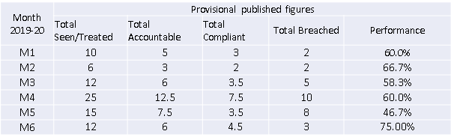
Responsive: 62 day urgent GP referral to first treatment cancer target
Data owner: John Pearcey – Assistant General Manager, lung division
The table below shows year to date provisional published 62 day urgent GP referral to first treatment activity.
M5 pathway breaches
All of the five patient pathway breaches that occurred during M5, and for for which the Trust had responsibility, occurred due to the complexity of the clinical condition of the patients.
The graph below shows the year to date total number of 62 day urgent GP referrals for surgery for cancer and demonstrates the allocation of breaches.

Slide 11
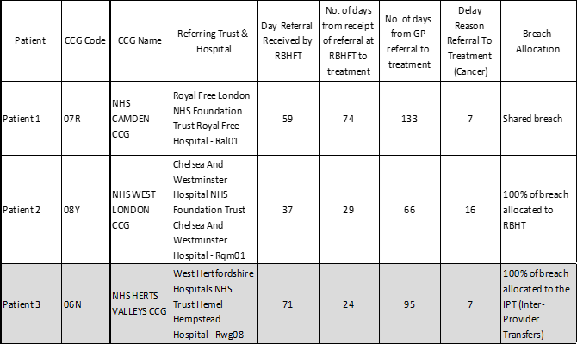
Responsive: 62 day urgent GP referral to first treatment cancer target and 31 day cancer pathway targets
Data owner: John Pearcey – Assistant General Manager, lung division
31 day to first definitive treatment waiting time standard
M6 pathway breaches
39 patients were treated on the 31 day to definitive treatment cancer pathway during M5 and all 39 patients were treated within the 31 day target.
29 patients were treated on the 31 day to definitive treatment cancer pathway during M6. All 29 patients were treated within the 31 day target.
31 day to subsequent treatment waiting time standard (M5)
Patient 1: Patient pathway breach occurred due to the complexity of the clinical condition of the patient.
Patient 2: Patient pathway breach occurred due patient choice.
20 patients were treated on the 31 day to subsequent treatment cancer pathway during M5 and all 20 patients were treated within the 31 day target.
12 patients were treated on the 31 day to subsequent treatment cancer pathway during M6. 10 patients were treated within the 31 day target and 2 patients were treated after 31 days
.
Patient 1: Cancellation was due to an urgent case in the operating theatre over running. It was not possible to readmit this patient before day 31.
Patient 2: The data for this patient pathway breach is currently being revalidated.

Slide 12
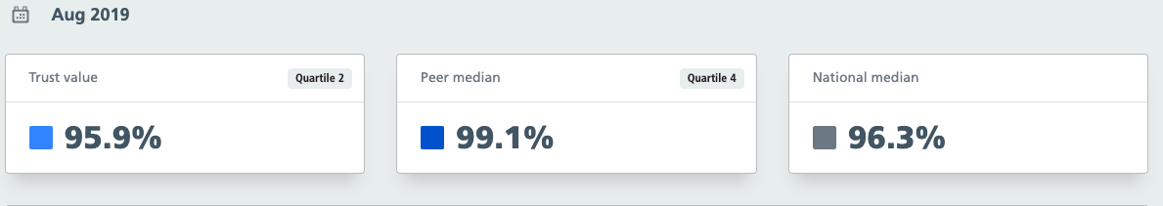
Caring: Patient experience
Data owner: Karen Taylor - Patient & Public Engagement and Williama Allieu - Complaints Lead
Inpatient Friends and Family Test (FFT) results
Latest NHS Model Hospital benchmark
Initiatives
Children and Young People’s Survey 2018
The results of the CQC Bi-Annual Children and Young People’s Survey 2018 will be published on 19 November. The Trust received 117 responses – a 25.3% response rate.
In Summary, the Trust’s results are excellent and some highlights are detailed below:
The Trust performed better than most other providers on 31 questions, worse than most on 0 questions and the same as others on 25 questions.
There was a significant improvement on:
  How clean do you think the room your child was cared for in?
  Did members of staff treating your child communicate in way they understood
  Did your child like the food?
  The Trust received lower scores for parent facilities, wifi quality and noise at night.
  The patient and public engagement team are currently working with the Rose Ward team to develop the response and action plan. The survey results will published on the Trust’s website.
Trailblazer Co-Chairs have contributed their ideas on The Ideal Hospital from a young person’s perspective. Prior to the meeting, they hosted a Youth Forum meeting to discuss hospital environments and facilities with additional young people to represent their views. Issues discussed included transition, mental health provision, inpatient facilities and networking/remote monitoring.
The Trailblazer’s 2020 programme is near completion and they will meet once more this year (to go ice-skating at the Natural History Museum, supported by the Brompton Fountain). The 2020 programme includes leadership training, social activities, trips and forum meetings.
Complaints
The Trust received 14 new complaints during M6 and 14 during M7. 23 of the complaints were acknowledged within 3 working days.
2 complaints were closed during M6 and both were closed within the agreed timeframe.
Key areas of feedback during M6 and M7 included
Waiting times
Facilities
Staff communication
All areas for improvement identified through the complaints process and from Friends and Family feedback are shared with the relevant departments so as improvements can be made.

Slide 13
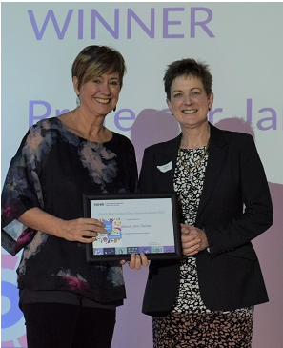
Effective: Cystic Fibrosis clinical trials
Data owner: Professor Davies - Honorary Consultant in paediatric respiratory medicine
Cystic Fibrosis (CF) Clinical Trials
The Royal Brompton Cystic Fibrosis (CF) Clinical Trials team celebrated three well-deserved wins at the North West London Clinical Research Awards, where they were recognised for their outstanding work carrying out ground-breaking CF research.
This award recognised the team’s outstanding collaborative work delivering better clinical research to patients and the public. In addition, Professor Davies received the award for outstanding principal investigator, and Rebecca Dobra, Clinical Research Fellow, received the ‘Rising Star’ award.
Nominations were judged by a panel of staff and patient representatives from across North West London, as well as a patient representative.
The team, which has many years’ experience running trials of new medicines, is supported by the Cystic Fibrosis Trust’s Clinical Trials Accelerator Platform (CTAP).
The Trials Accelerator has given Royal Brompton Hospital the capacity to scale up on clinical trials in partnership with a network of other London CF Centres, which include King’s College, Great Ormond Street and the Barts Hospitals.
The partnership was established by Professor Davies, leader of the network, to share expertise and position trials optimally across each of the centres. The network is a flagship of the Trials Accelerator, with trial activity now taking place across the capital and providing valuable opportunities for referrals between teams. This way the London population of around 2,000 people with CF have fairer opportunities to take part in ground-breaking clinical trials.
Well led: The Sunflower Scheme
Data owner: Penny Agent – Director of Allied Clinical services, Rehabilitation and Therapies
The Sunflower scheme is a national campaign already in place in airports, supermarkets and some businesses, used to discreetly show a person has a hidden disability and may require additional support or assistance.
A hidden disability can’t always be seen and can include sensory loss (visual or hearing impairment), autism, dementia, a learning disability, mental health conditions or a physical disability that isn’t obvious. The Trust is launching the scheme initially for patients and their family/carers.
Resources (lanyards and wristbands) for patients are being made available at key points across the Trust sites during November and training will be provided to key staff.
The items for this scheme have very kindly been funded by The Brompton Fountain and we thank them for their generous support.

Slide 14
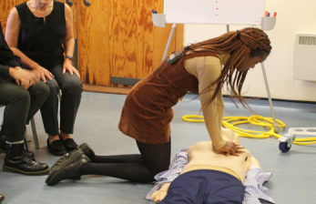
Well led: Your Heart Hospital
Data owner: Dr Miles Dalby, Consultant Cardiologist at Harefield Hospital
A public event to ‘demystify’ what goes on in a specialist heart hospital took place in October and attracted more than 160 staff, patients and members of the public, including over a hundred students from local schools keen to improve their resuscitation skills. Harefield Hospital’s annual event Your Heart Hospital, now in its 13th year, was held for the first time in partnership with the British Cardiovascular Society (BCS). BCS President Professor Simon Ray welcomed delegates.
Dr Miles Dalby, Consultant Cardiologist at Harefield Hospital, said: “Central to our event has been to demystify what goes on in a heart hospital like ours. We want to enhance an understanding within the community about the causes, prevention and treatment of heart disease.”
A crucial part of the day was to teach practical, yet essential, resuscitation skills using simulated scenarios. Eighty per cent of cardiac arrests happen in the home, so a patient’s first contact is not with a specialist but rather a family member or a member of the public. If that person can give cardio pulmonary resuscitation immediately, the chances of survival are significantly increased.
Well led: Rainbow Badges
Data owner: Penny Agent – Director of Allied Clinical services, Rehabilitation and Therapies
Rainbow Badges was launched over the summer and is an initiative that gives staff a way to show that Royal Brompton and Harefield NHS Foundation Trust offers open, non-judgemental and inclusive care for patients (whether they be adults, children or young people) and their families and friends, who identify as LGBT+ (lesbian, gay, bi, trans, the + simply means that we are inclusive of all identities, regardless of how people define themselves.)
This initiative further expands Trust’s reputation for inclusivity and openness and it provides support and care to both our LGBT+ patients and staff.

Slide 15
Additional Performance Data

Slide 16
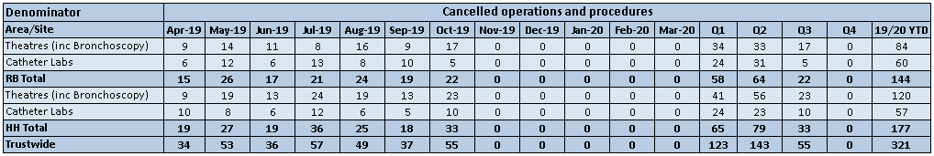
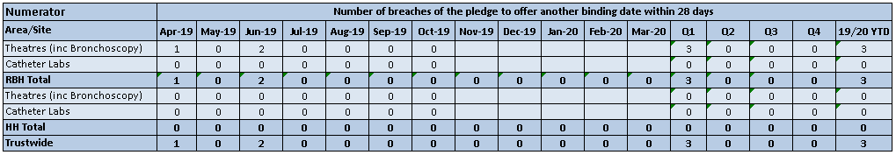
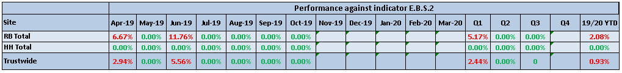
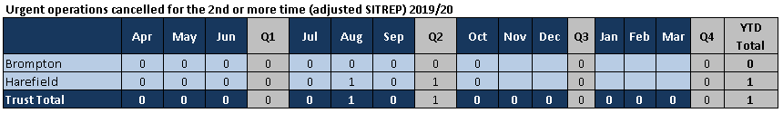
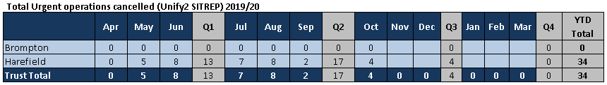
Responsive: Cancelled operations and procedures
Data owner: Derval Russell – Harefield Hospital Director and Ross Ellis – Royal Brompton Hospital Director

Slide 17
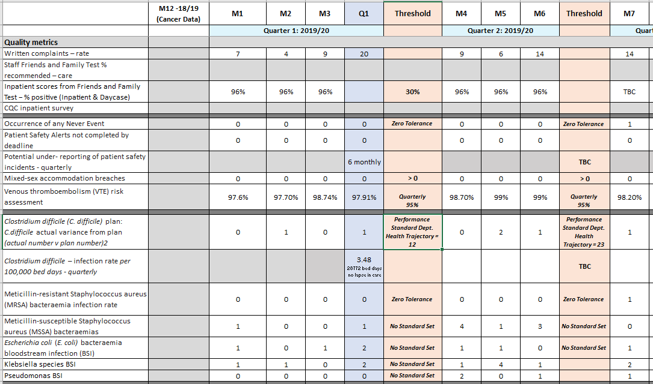
Single Oversight Framework Quality Metrics

Slide 18
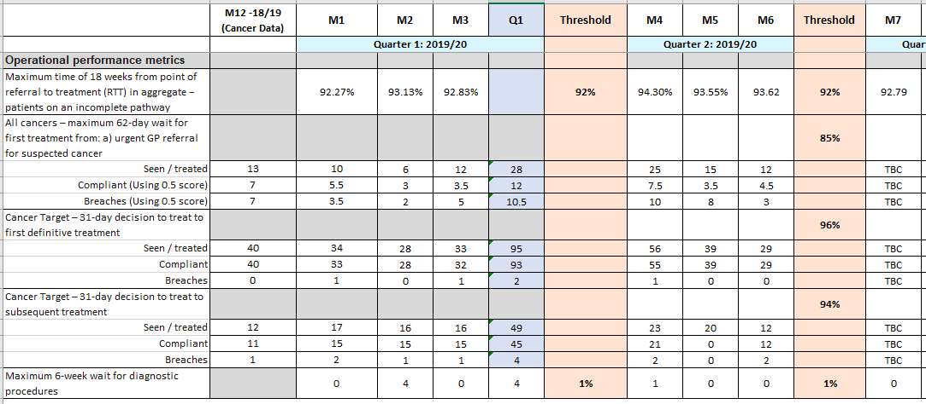
Single Oversight Framework Operational Metrics

Slide 19
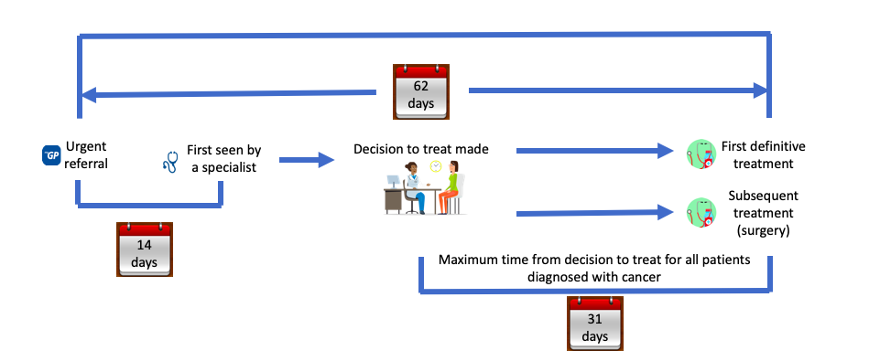
For information: Cancer pathways overview

