Slide 1
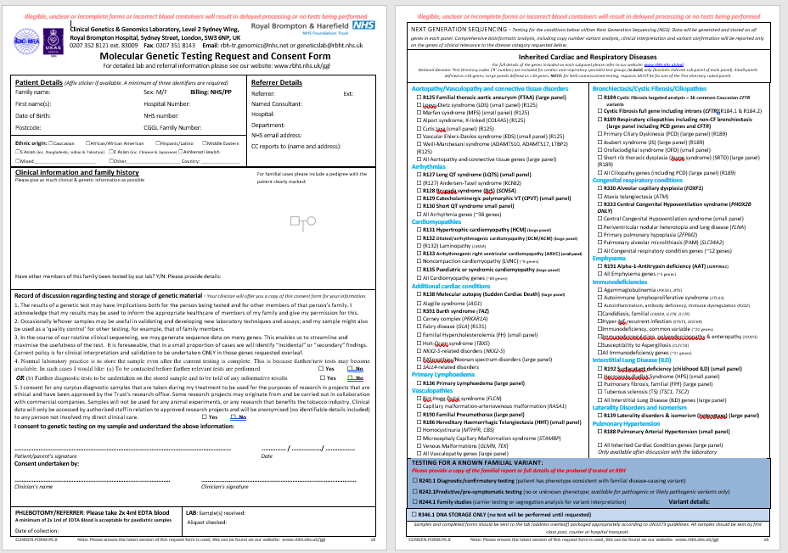
Please provide as many clinical details as possible about the patient, including the indication for testing, whether there are any other affected family members and a pedigree if possible.
If NGS is required please select disease sub-panel/s from this section.
If there is a known familial variant, please select an option from the blue section. Ensure you send a copy of a report detailing the familial variant.
This consent section MUST be signed by the patient. Sample accompanied by an unsigned form will not be processed. If the patient or guardian is unable to sign, this may be signed by the referring clinician with an appropriate note.
If the testing required has yet to be decided, or the sample may be required in the future please tick this box to store DNA.

